Slide 1

A Project Presentation on IOT BASED SEED SPRAYER
Presentation by :
MUSKAN CHAUHAN - 2305250310029
MONALI NISHAD- 2305250310027
MUSKAN NISHAD- 2305250310030
SANDHYA SAHANI- 2305250310047
Under the guidance of :
ARUN KUMAR MISHRA
Department of Electronics and communication Engineering
Buddha Institute of Technology, GIDA, Gorakhpur

Slide 2
CONTENT
Brief Introduction
Literature Review
Objective of the project
Feasibility Study
Methodology/Technology used
Social/Environmental Relevance of Proposed work
Conclusion
References

Slide 3
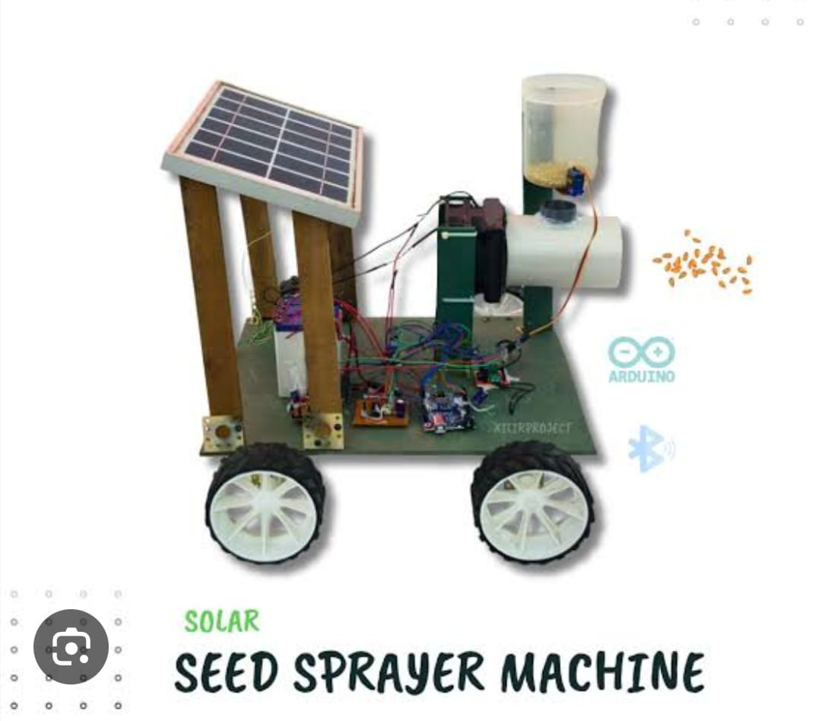
IoT Based Seed Sprayer is a smart agriculture system used for automatic seed sowing and spraying. • It uses sensors, microcontrollers (Arduino/Node MCU), and IoT technology to monitor field conditions. • The system can automatically control seed spraying based on soil conditions and user input. • Traditional farming methods are time-consuming, labor-intensive, and may lead to uneven seed distribution.
Brief Introduction

Slide 4
Literature Review
Traditional farming methods rely on manual seed sowing and irrigation, which are time-consuming and labor-intensive.
• Earlier techniques lacked real-time monitoring of soil conditions such as moisture, temperature, and humidity.
• Recent research focuses on IoT-based smart agriculture systems using sensors and wireless communication.
.

Slide 5
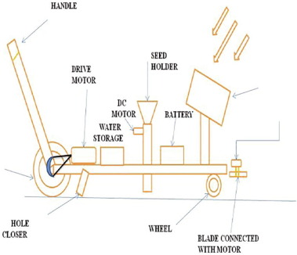
Objective of the project
Here are the objectives of an IoT-based Seed Sprayer project in clear points:
Automation of Seed Spraying
Efficient Use of Seeds
To ensure uniform and controlled distribution of seeds, minimizing wastage.
Remote Monitoring and Control
To allow farmers to monitor and control the sprayer using mobile apps or internet-based systems.
Time and Labor Saving

Slide 6
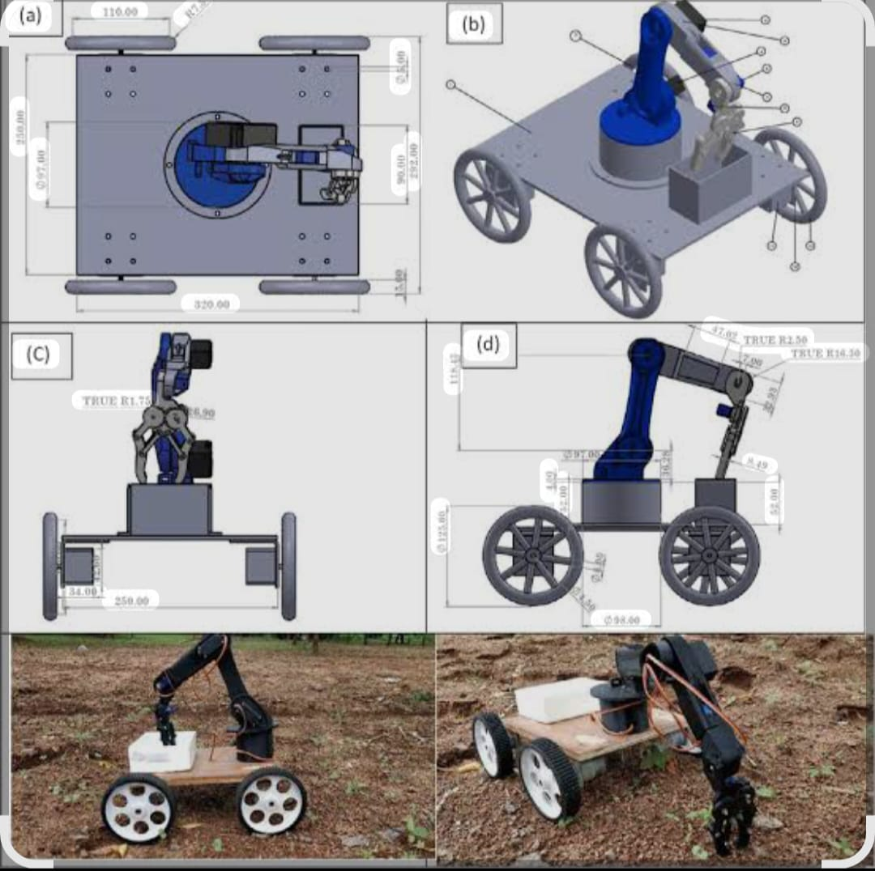
Feasibility Study
🔹 Technical Feasibility
-AI/ML algorithms can accurately detect spectrum availability
-Software Defined Radio (SDR) supports real-time signal processing
-System can work under different noise and signal conditions
🔹 Economic Feasibility
-Requires low-cost hardware and mostly software implementation
-Reduces spectrum wastage → improves overall efficiency
-Scalable system with minimal additional cost
🔹 Operational Feasibility
-Easy integration with existing wireless networks
-Supports real-time decision-making
-Requires minimal human intervention (automated system)=---

Slide 7
Methodology/Technology
🔹 Methodology
1. System Design
Design a smart seed sprayer system using IoT techno
2. Hardware Implementation
Connect all components properly:
Soil moisture sensor → monitors soil condition
Microcontroller → processes data
Motor driver → controls seed dispensing motor
Pump → sprays water or seeds
3. Software Development
Program the microcontroller using embedded C/Arduino IDE.
4. IoT Integration
Connect system to internet using Wi-Fi (ESP8266/ESP32).

Slide 8
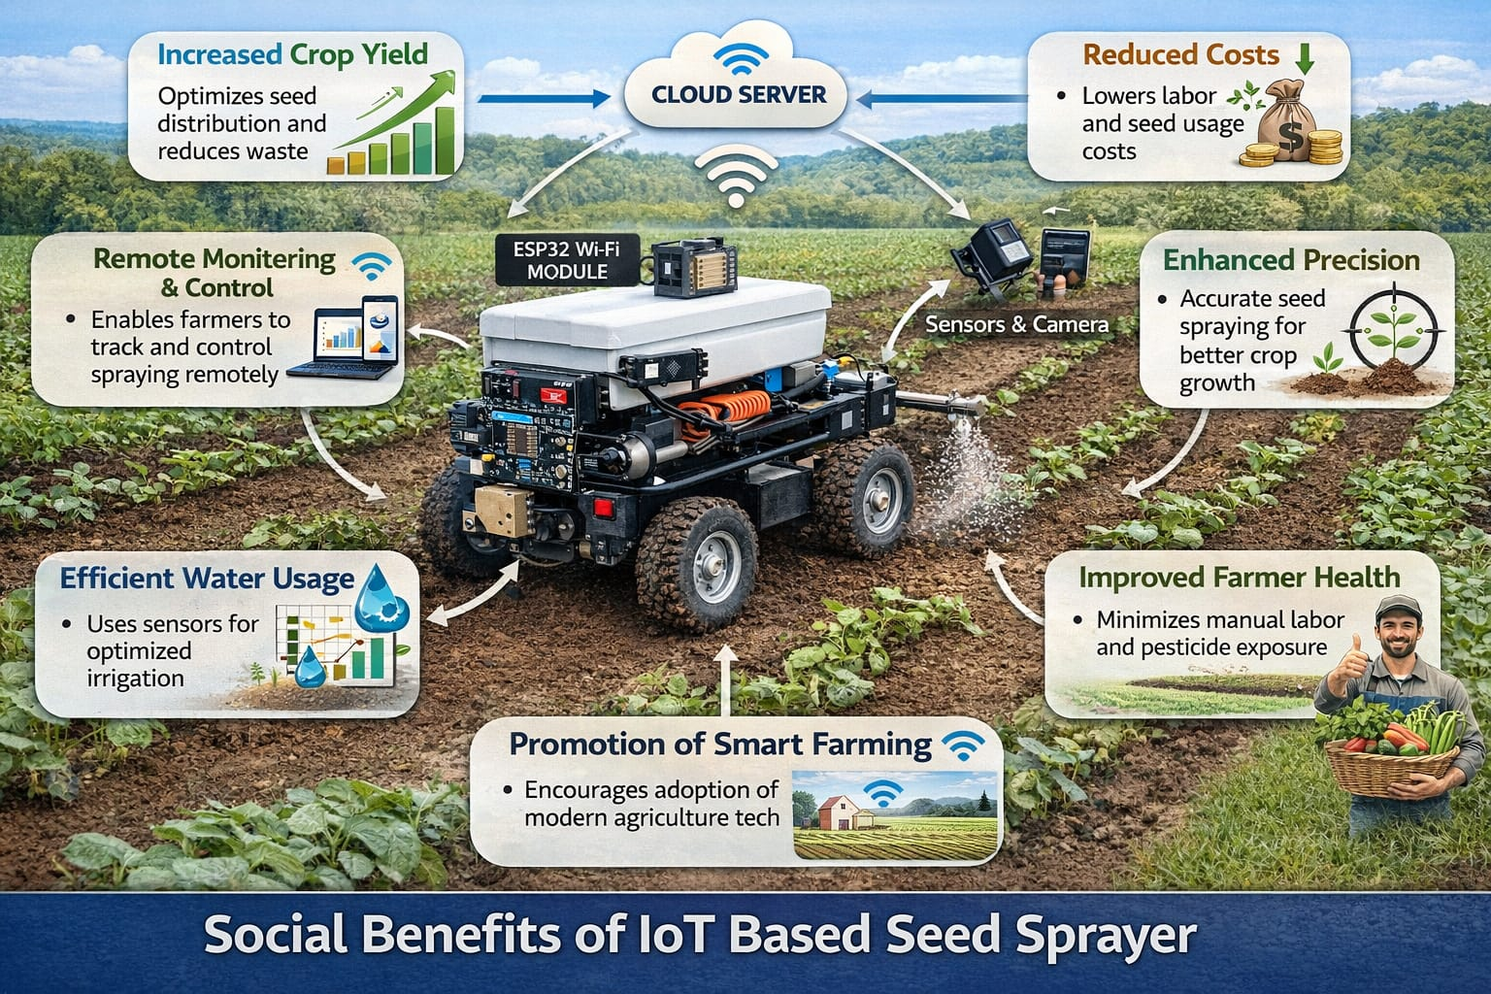
Social /Environmental Relevance
• Improves efficient use of water and seeds, reducing wastage of natural resources.
• Supports sustainable agriculture by minimizing over-irrigation and soil damage.
• Reduces manual labor, making farming easier and less time-consuming for farmers.
• Enhances crop productivity and quality, leading to better income for farmers.

Slide 9
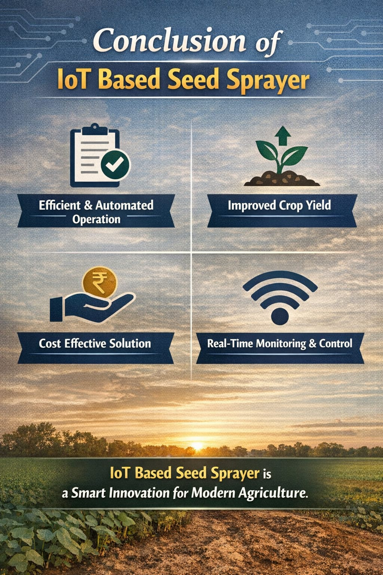
Conclusion
• The IoT-based seed sprayer provides an efficient and automated solution for modern agriculture.
• It helps in reducing manual labor and saving time for farmers.
• The system ensures uniform seed distribution and optimal resource utilization.
• It minimizes water and seed wastage using real-time monitoring and control.
• The project improves crop productivity and overall farming efficiency.

Slide 10
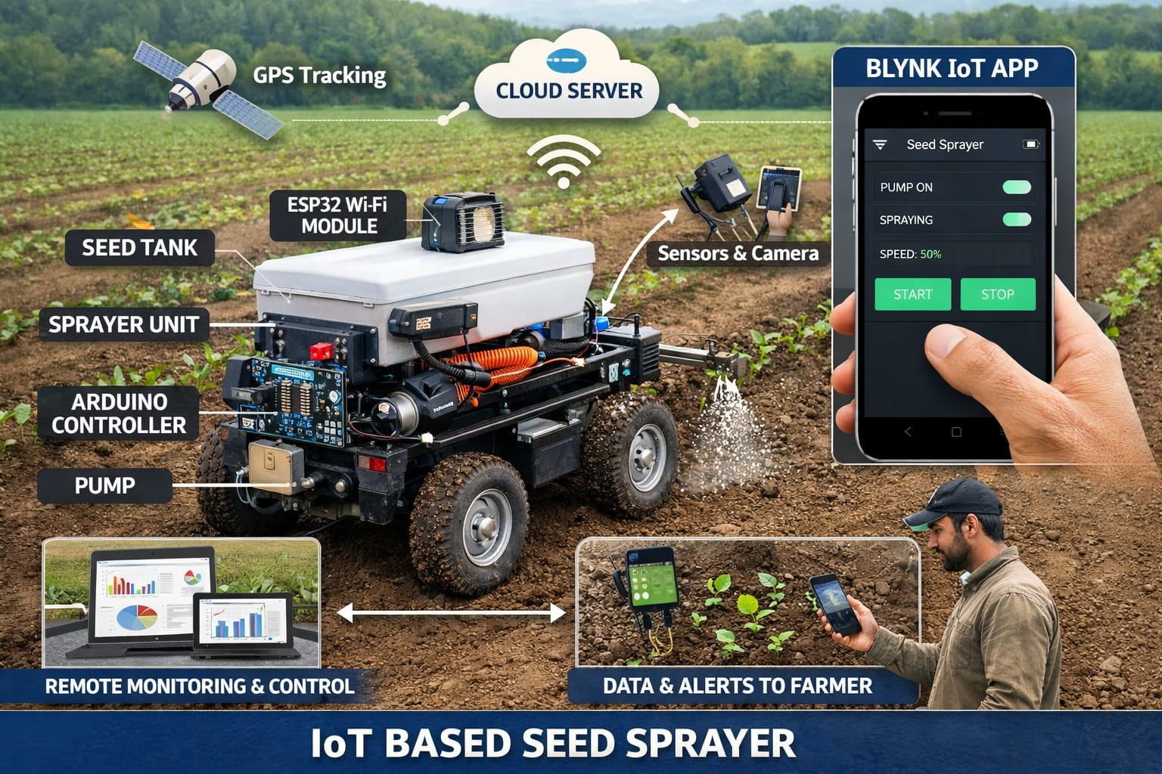
Reference
References
Internet of Things: A Hands-On Approach
– Used for understanding IoT concepts, architecture, and real-world applications.
Getting Started with Arduino
– Reference for Arduino programming and hardware interfacing.
Arduino IDE
– Used for coding and uploading programs to the microcontroller.
Blynk IoT App
– Used for remote monitoring and control of the seed sprayer system.

Slide 11
THANK YOU

